Slide 1
CHAPTER 9
The Capital Asset Pricing Model

Slide 2
Capital Asset Pricing Model (CAPM)
9-<number>
It is the equilibrium model that underlies all modern financial theory
Derived using principles of diversification with simplified assumptions
Markowitz, Sharpe, Lintner and Mossin are researchers credited with its development

Slide 3
Assumptions
9-<number>
Individual investors are price takers
Single-period investment horizon
Investments are limited to traded financial assets
No taxes and transaction costs
Information is costless and available to all investors
Investors are rational mean-variance optimizers
There are homogeneous expectations

Slide 4
Resulting Equilibrium Conditions
9-<number>
All investors will hold the same portfolio for risky assets – market portfolio
Market portfolio contains all securities and the proportion of each security is its market value as a percentage of total market value

Slide 5
Resulting Equilibrium Conditions
9-<number>
Risk premium on the market depends on the average risk aversion of all market participants
Risk premium on an individual security is a function of its covariance with the market

Slide 6
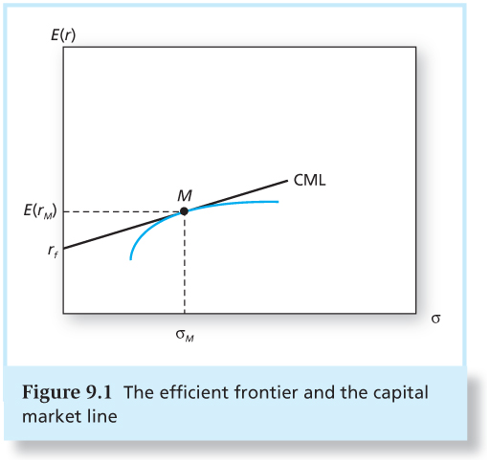
Figure 9.1 The Efficient Frontier and the Capital Market Line
9-<number>

Slide 7
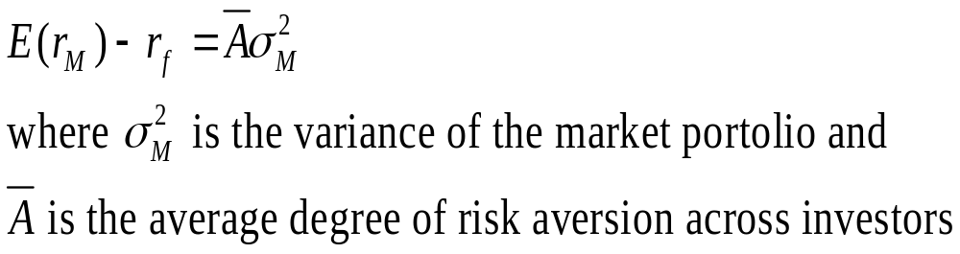
Market Risk Premium
9-<number>
The risk premium on the market portfolio will be proportional to its risk and the degree of risk aversion of the investor:

Slide 8
Return and Risk For Individual Securities
9-<number>
The risk premium on individual securities is a function of the individual security’s contribution to the risk of the market portfolio.
An individual security’s risk premium is a function of the covariance of returns with the assets that make up the market portfolio.

Slide 9
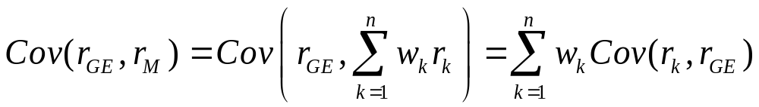
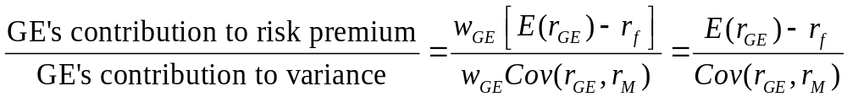
GE Example
9-<number>
Covariance of GE return with the market portfolio:
Therefore, the reward-to-risk ratio for investments in GE would be:

Slide 10
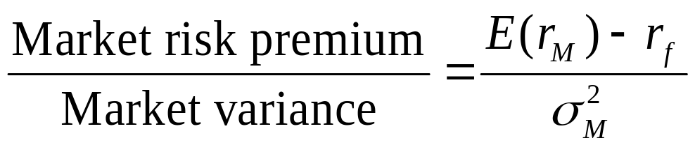
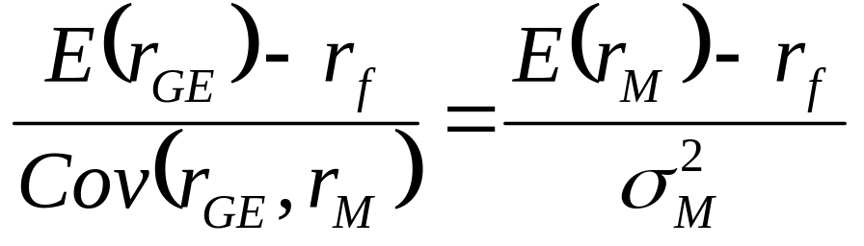
GE Example
9-<number>
Reward-to-risk ratio for investment in market portfolio:
Reward-to-risk ratios of GE and the market portfolio should be equal:

Slide 11
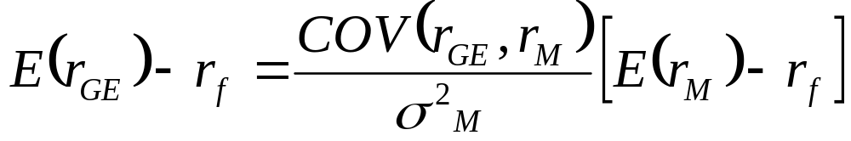
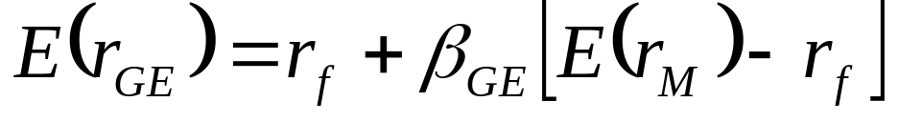
GE Example
9-<number>
The risk premium for GE:
Restating, we obtain:

Slide 12
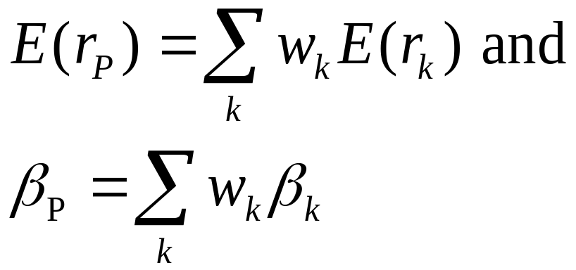
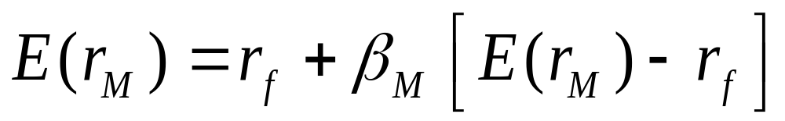
Expected Return-Beta Relationship
9-<number>
CAPM holds for the overall portfolio because:
This also holds for the market portfolio:

Slide 13
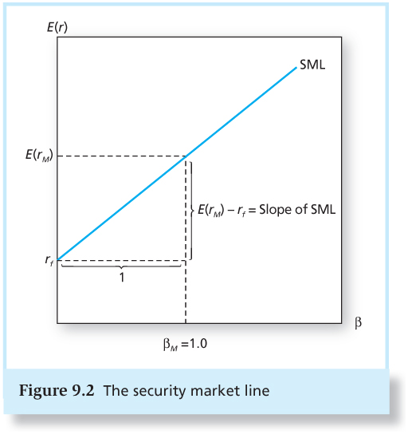
Figure 9.2 The Security Market Line
9-<number>

Slide 14
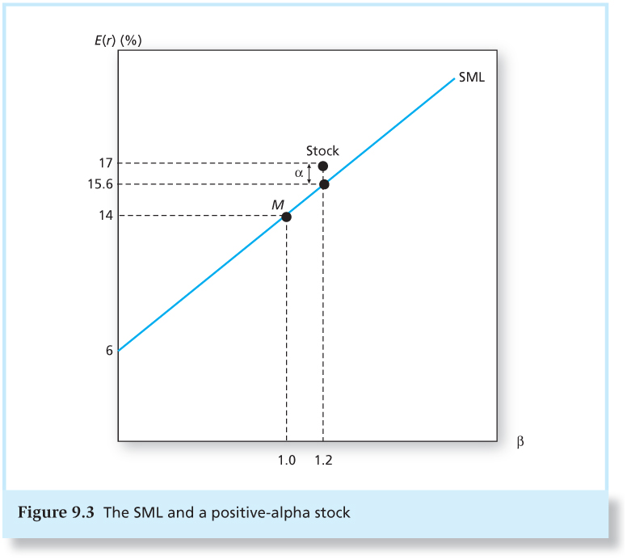
Figure 9.3 The SML and a Positive-Alpha Stock
9-<number>

Slide 15
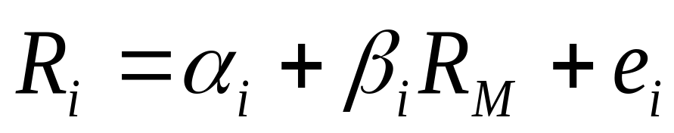
The Index Model and Realized Returns
9-<number>
To move from expected to realized returns, use the index model in excess return form:
The index model beta coefficient is the same as the beta of the CAPM expected return-beta relationship.

Slide 16
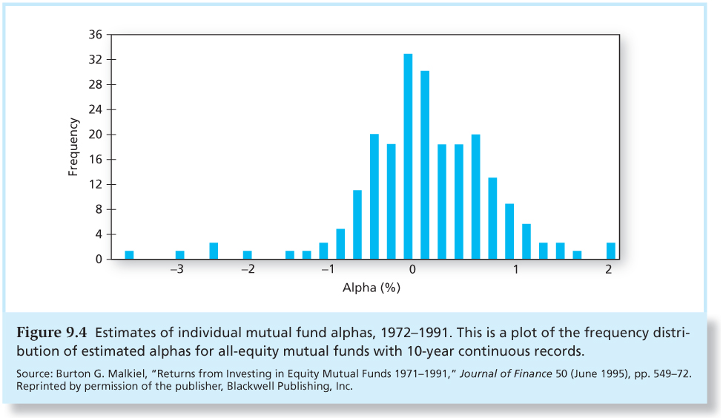
Figure 9.4 Estimates of Individual Mutual Fund Alphas, 1972-1991
9-<number>

Slide 17
Is the CAPM Practical?
9-<number>
CAPM is the best model to explain returns on risky assets. This means:
  Without security analysis, α is assumed to be zero.
  Positive and negative alphas are revealed only by superior security analysis.

Slide 18
Is the CAPM Practical?
9-<number>
We must use a proxy for the market portfolio.
CAPM is still considered the best available description of security pricing and is widely accepted.

Slide 19
Econometrics and the Expected Return-Beta Relationship
9-<number>
Statistical bias is easily introduced.
Miller and Scholes paper demonstrated how econometric problems could lead one to reject the CAPM even if it were perfectly valid.

Slide 20
Extensions of the CAPM
9-<number>
Zero-Beta Model
  Helps to explain positive alphas on low beta stocks and negative alphas on high beta stocks
Consideration of labor income and non-traded assets

Slide 21
Extensions of the CAPM
9-<number>
Merton’s Multiperiod Model and hedge portfolios
Incorporation of the effects of changes in the real rate of interest and inflation
Consumption-based CAPM
Rubinstein, Lucas, and Breeden
Investors allocate wealth between consumption today and investment for the future

Slide 22
Liquidity and the CAPM
9-<number>
Liquidity: The ease and speed with which an asset can be sold at fair market value
Illiquidity Premium: Discount from fair market value the seller must accept to obtain a quick sale.
  Measured partly by bid-asked spread
  As trading costs are higher, the illiquidity discount will be greater.

Slide 23
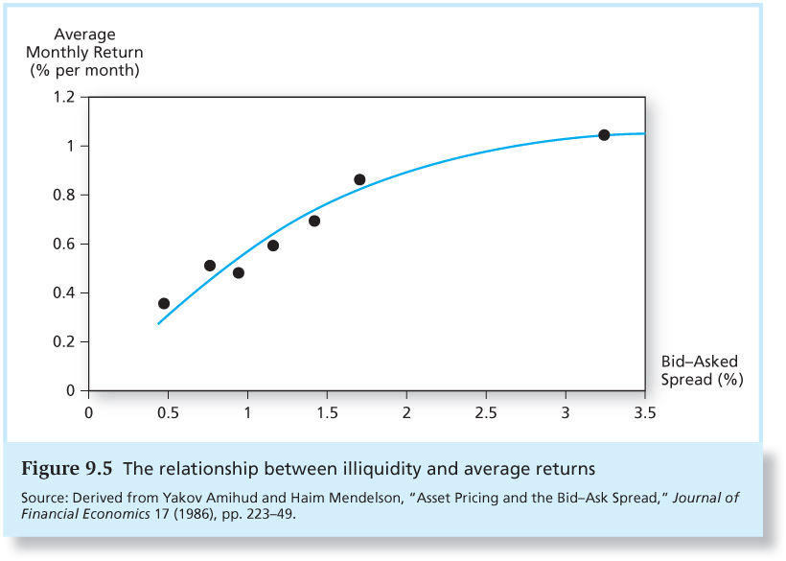
Figure 9.5 The Relationship Between Illiquidity and Average Returns
9-<number>

Slide 24
Liquidity Risk
9-<number>
In a financial crisis, liquidity can unexpectedly dry up.
When liquidity in one stock decreases, it tends to decrease in other stocks at the same time.
Investors demand compensation for liquidity risk
  Liquidity betas

